Slide 1
Anti-Slavery Movment
Jameson Haynes, Adam Hoffensetz, Gus Keish, Ethan Marks, and Jai Patel

Slide 2
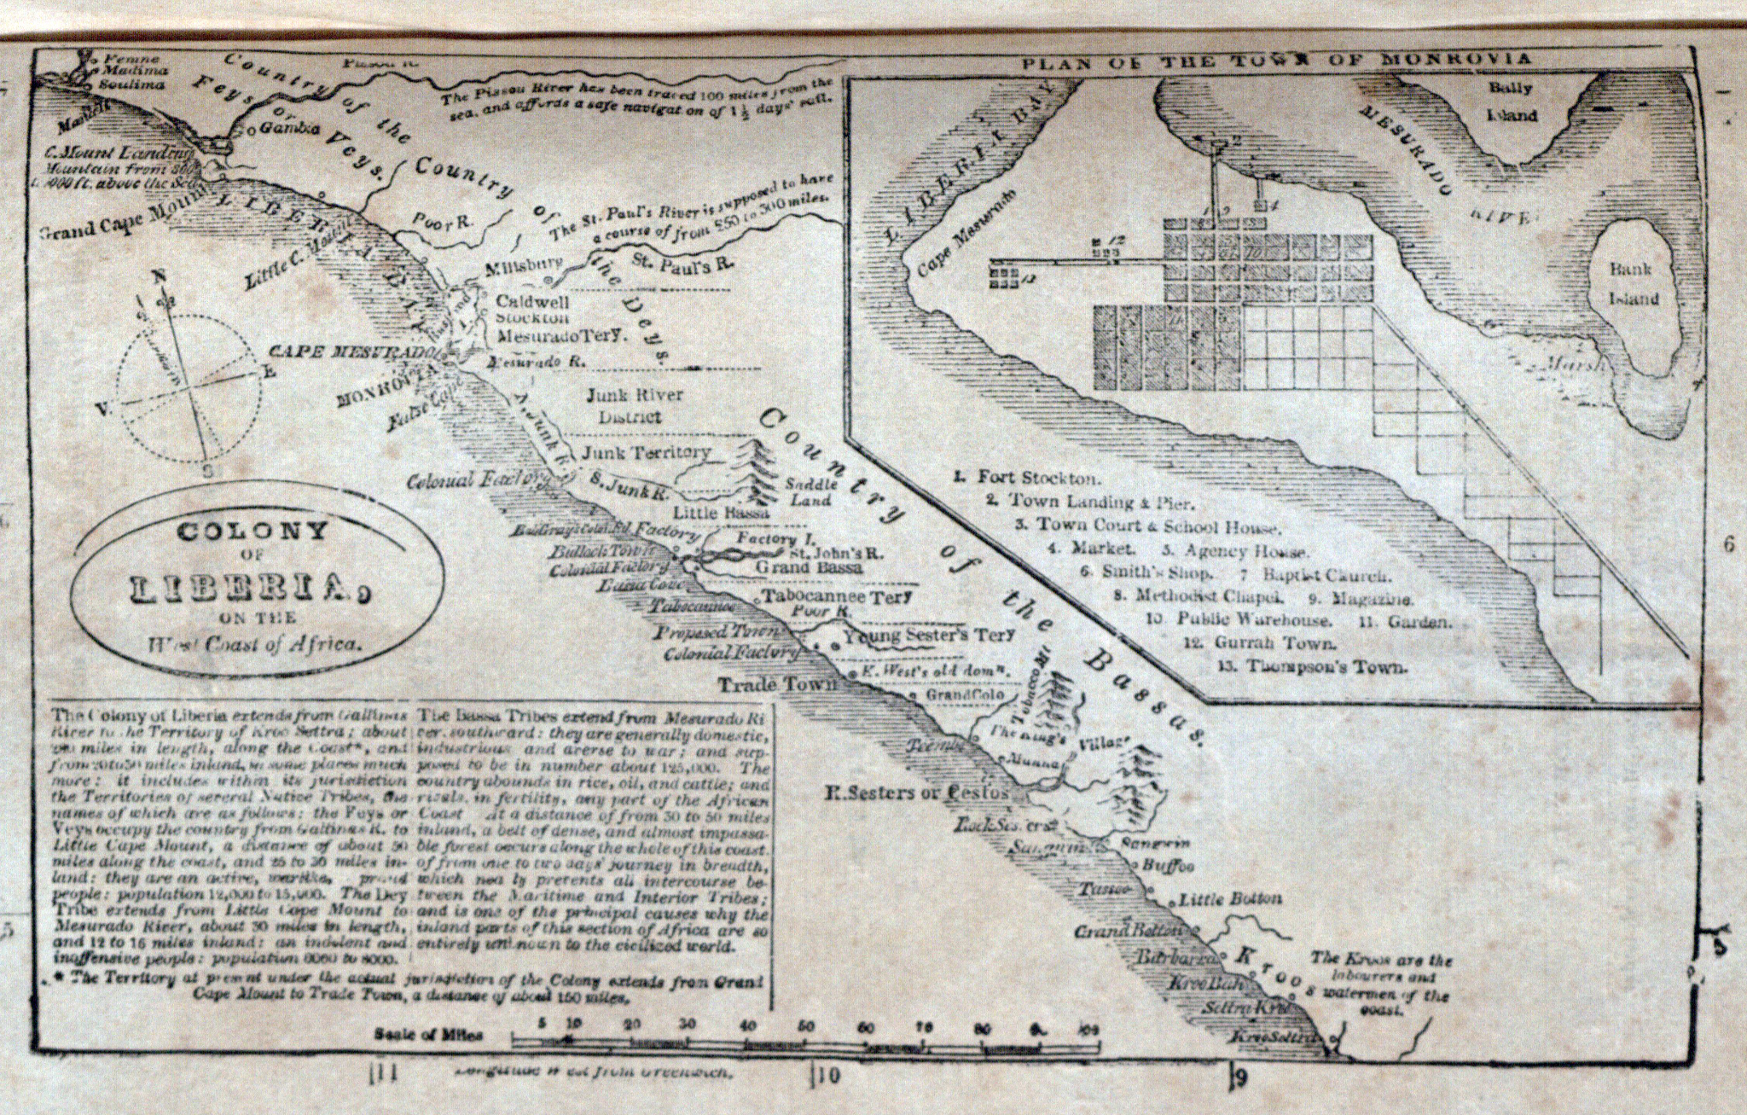
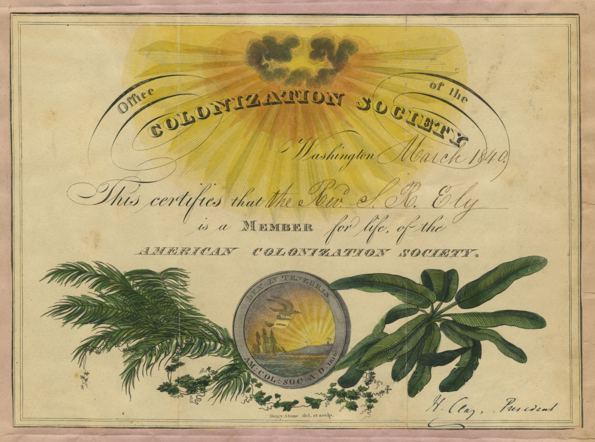
American Colonization Society
Transporting freed slaves to African colony (first tried in 1817)
Appealed to some oppoents of slavery as well as those who did not want free African Americans in the country
African American settlement was created by the society in Monrovia, Liberia in 1822
It was not very successful, many African Americans did not want to leave their birthplace

Slide 3
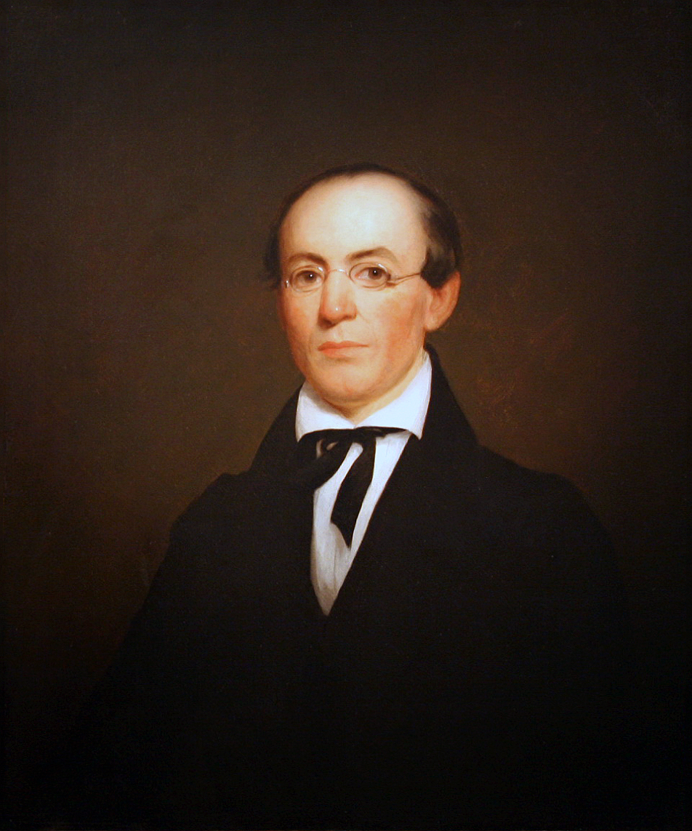
Evangelical Abolitionism
Evangelical Christians warned of damnation by a just God for holding slaves
Used Christian beliefs and the Bible to make arguments
One notable example: William Lloyd Garrison
Lived from 1805 - 1879
Worked in Baltimore during the 1820s
A determined abolitionist and evangelical christian
Started the American Anti-Slavery Society

Slide 4
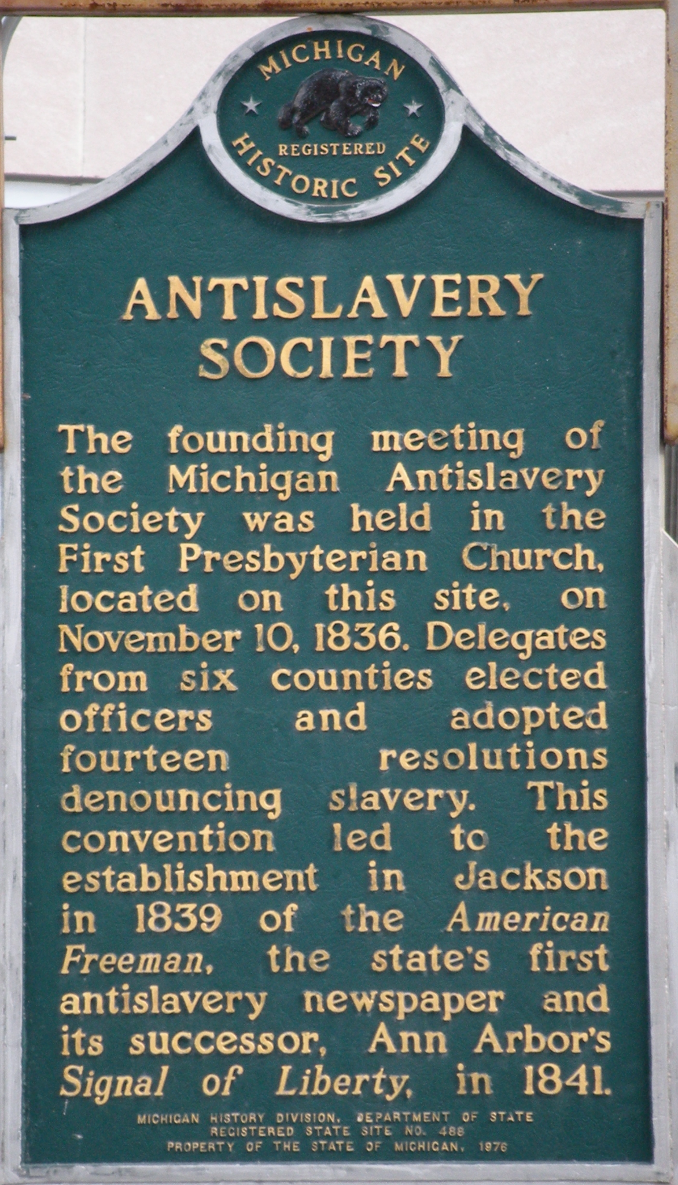
American Anti-Slavery Society
Garrison began publishing The Liberator, an abolitionist newspaper, in 1831
Wanted immediate abolition of slavery with no compensation for slave owner
The American Anti-Slavery Society was founded in 1833 by Garrison and other abolitionists
Garrison said the Constitution was a proslavery document and burned it
“No Union with Slaveholders”

Slide 5
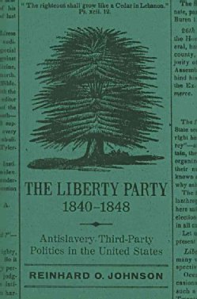
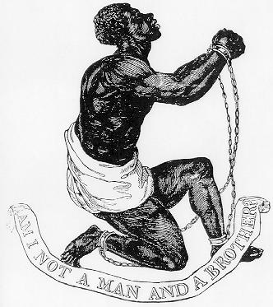
Liberty Party
Garrison seen as radical
Led to split in followers over preferred methods
Liberty Party formed in 1840, advocated legally ending slavery
Ran candidates in 1840 and 1844
Pledged to ending slavery through political means

Slide 6
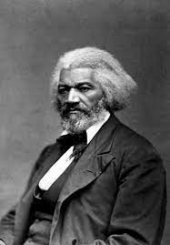
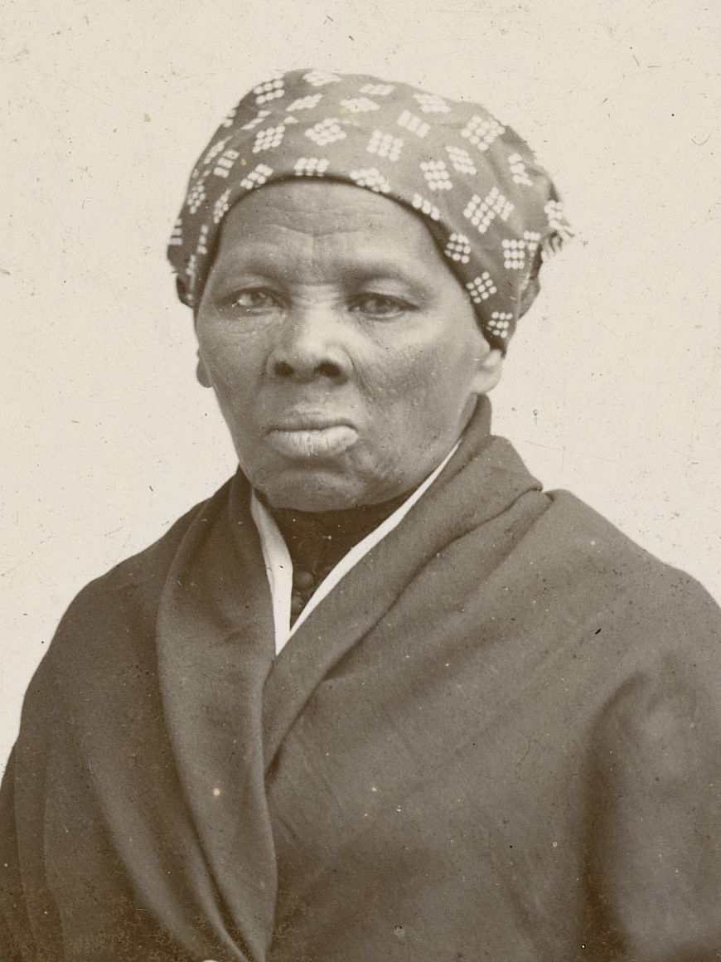
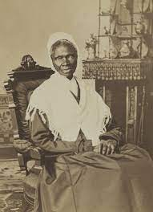
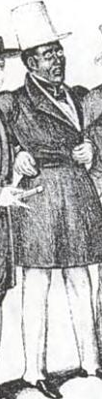
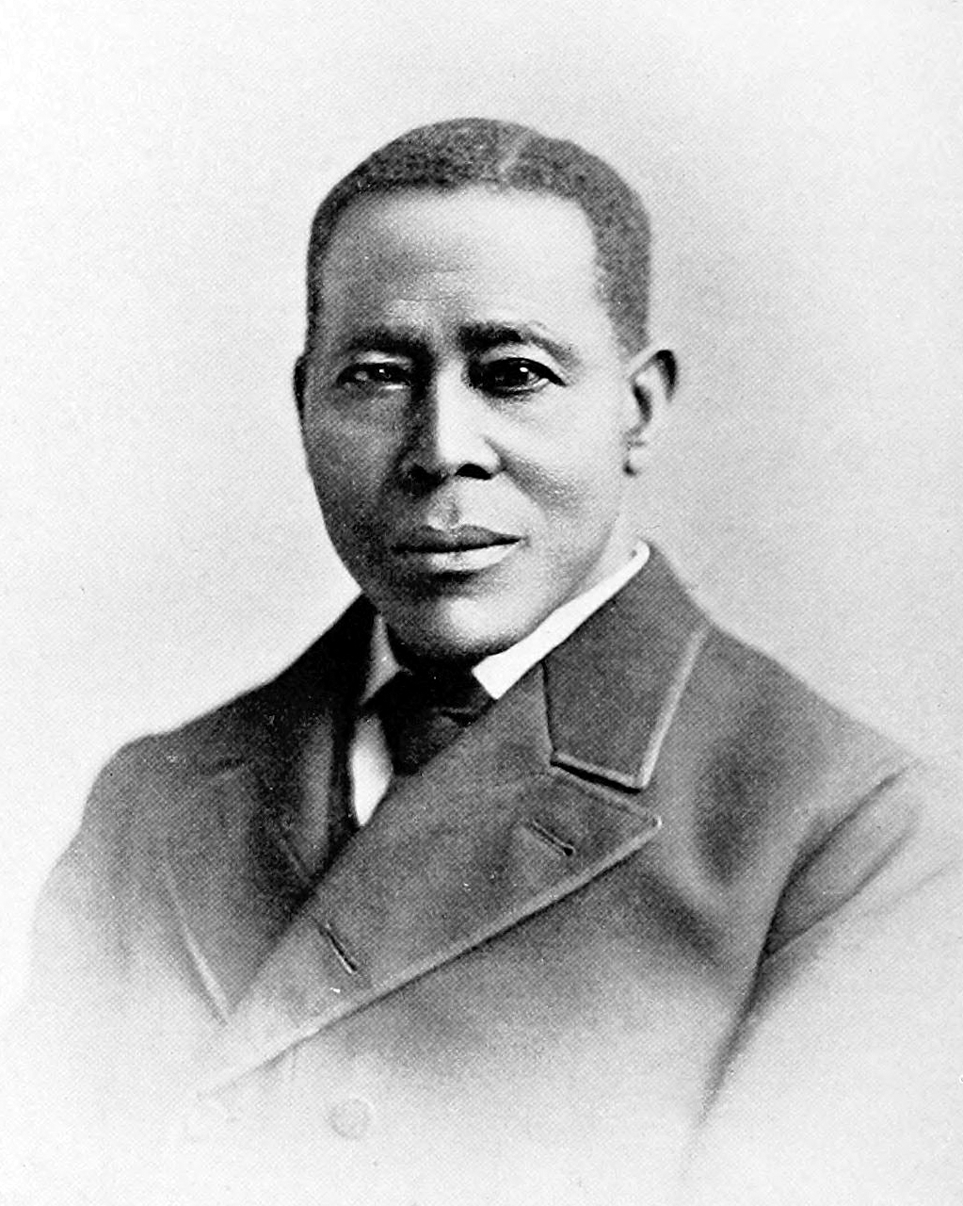
Black Abolitionists
Fredick Douglass was a former slave who spoke out against the brutality of slavery
Sojourner Truth was born into slavery and eventually escaped she became a womans right activist
Harret Tubman who was born into slavery escaped slavery and made 13 return journies to free 70 slaves
Still was a conductor on the underground Railroad and civil rights activist
David Ruggles was a African American Abolitionist who was a member of the committee of vigilance
Notes:
Gus Keish

Slide 7
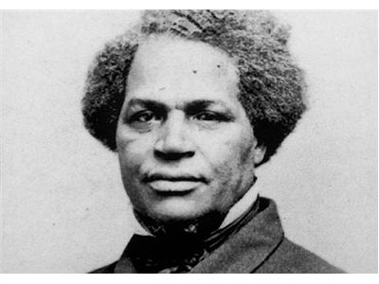
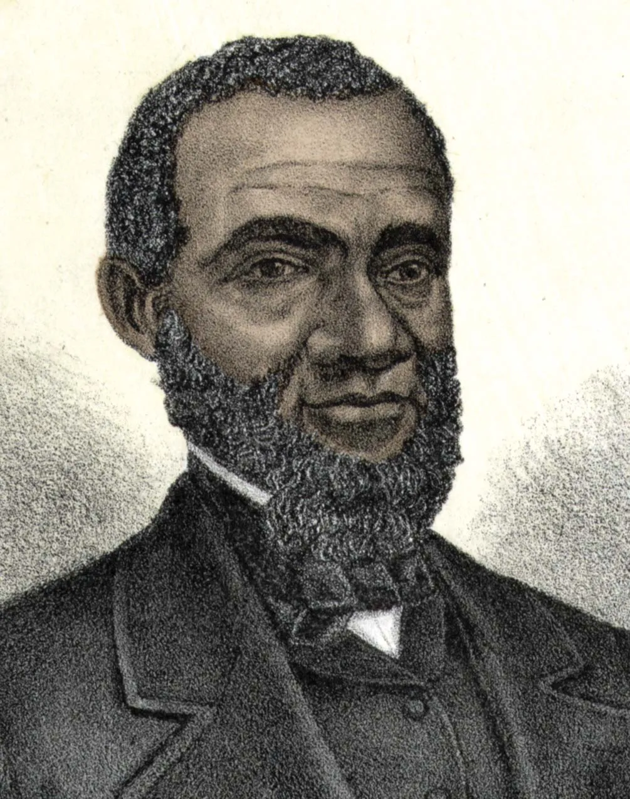
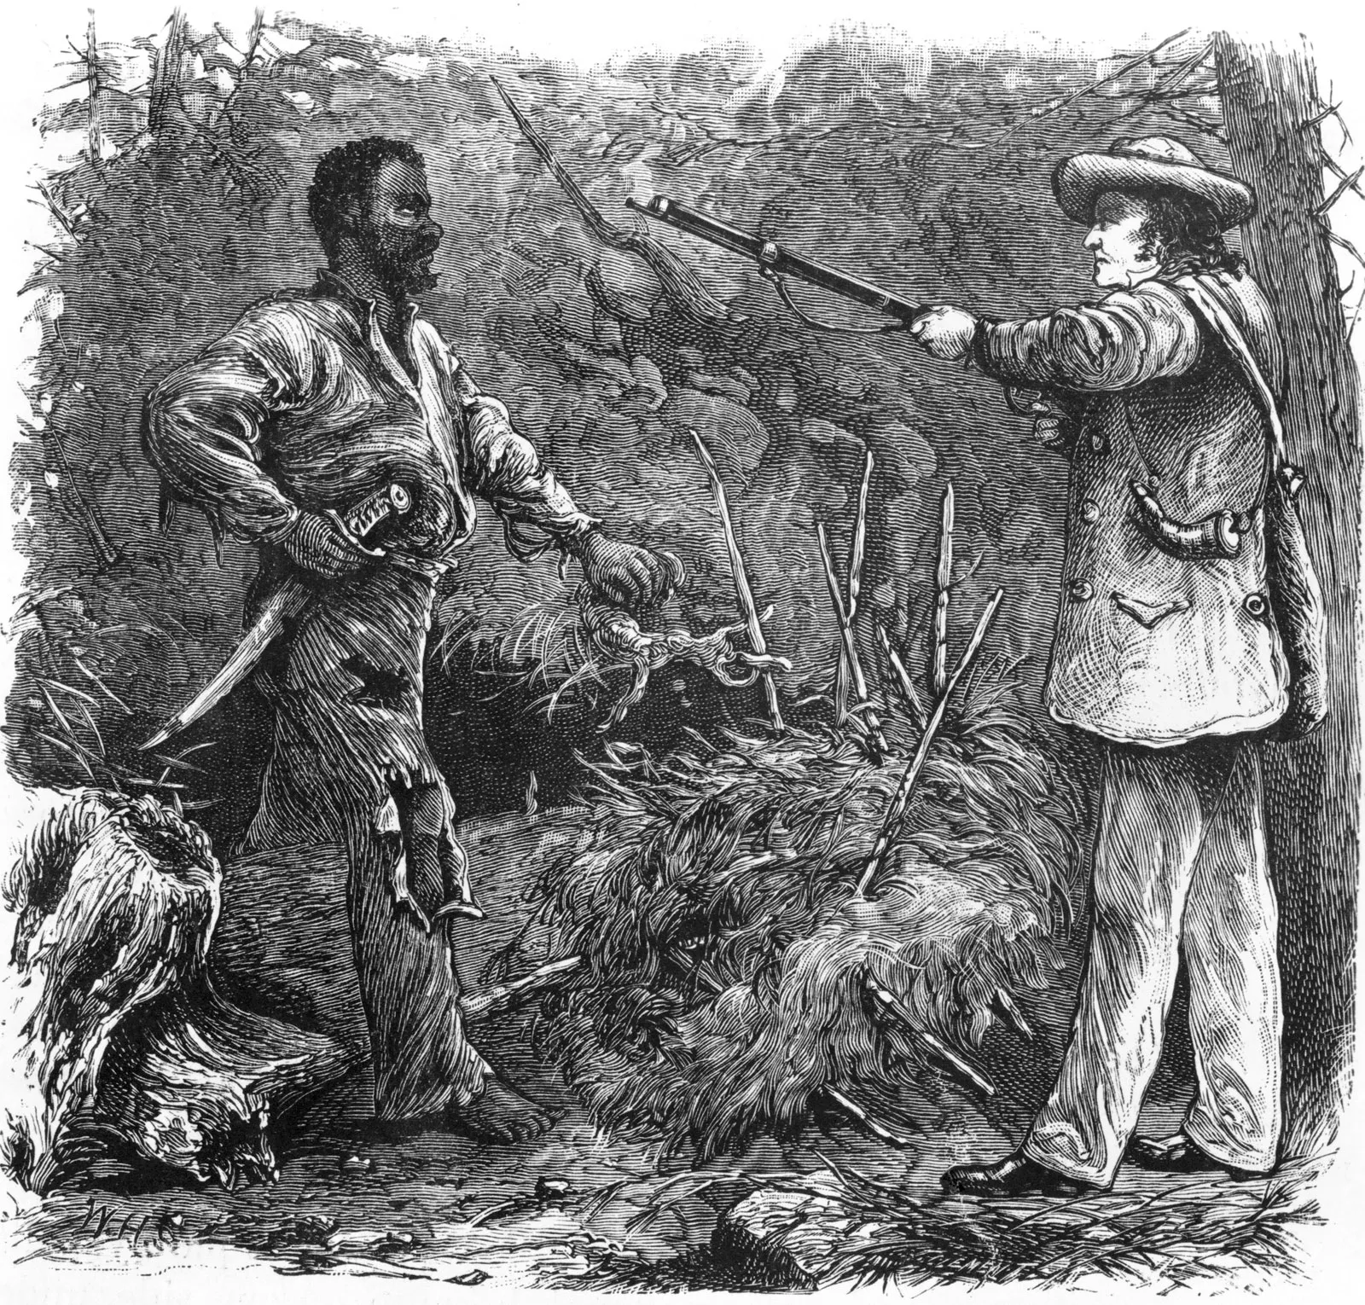
Violent Abolitionism
David Walker and Henry Highland, both northern African Americans who advocated for slaves to revolt agaisnt their owners.
Nat Turner led a revolt in 1831 which killed 55 whites, in response Whites brutally killed hundreds of African Americans.
Turner’s revolt led to the end of antislavery talk in the South

Slide 8
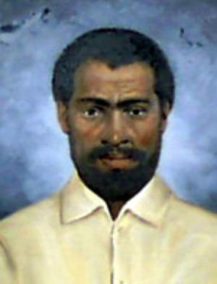
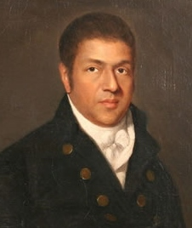
Black Social Thought: Uplift, Race Equality and Rebellion
Encouraged free Black Americans to “elevate” themselves to be the Whites equal
Schools, churches, and self help associations were founded to make Black and White Americans equal
Nat Turner was a slave in Virginia and Revolted against slavery with 60 other slaves by killing 55 white men.
Virginia’s assembly voted on a bill to gradually emancipate and it failed by a vote of 73 to 58
This bill eliminated the possibility of Southern planters from voluntarily ending slavery

Slide 9
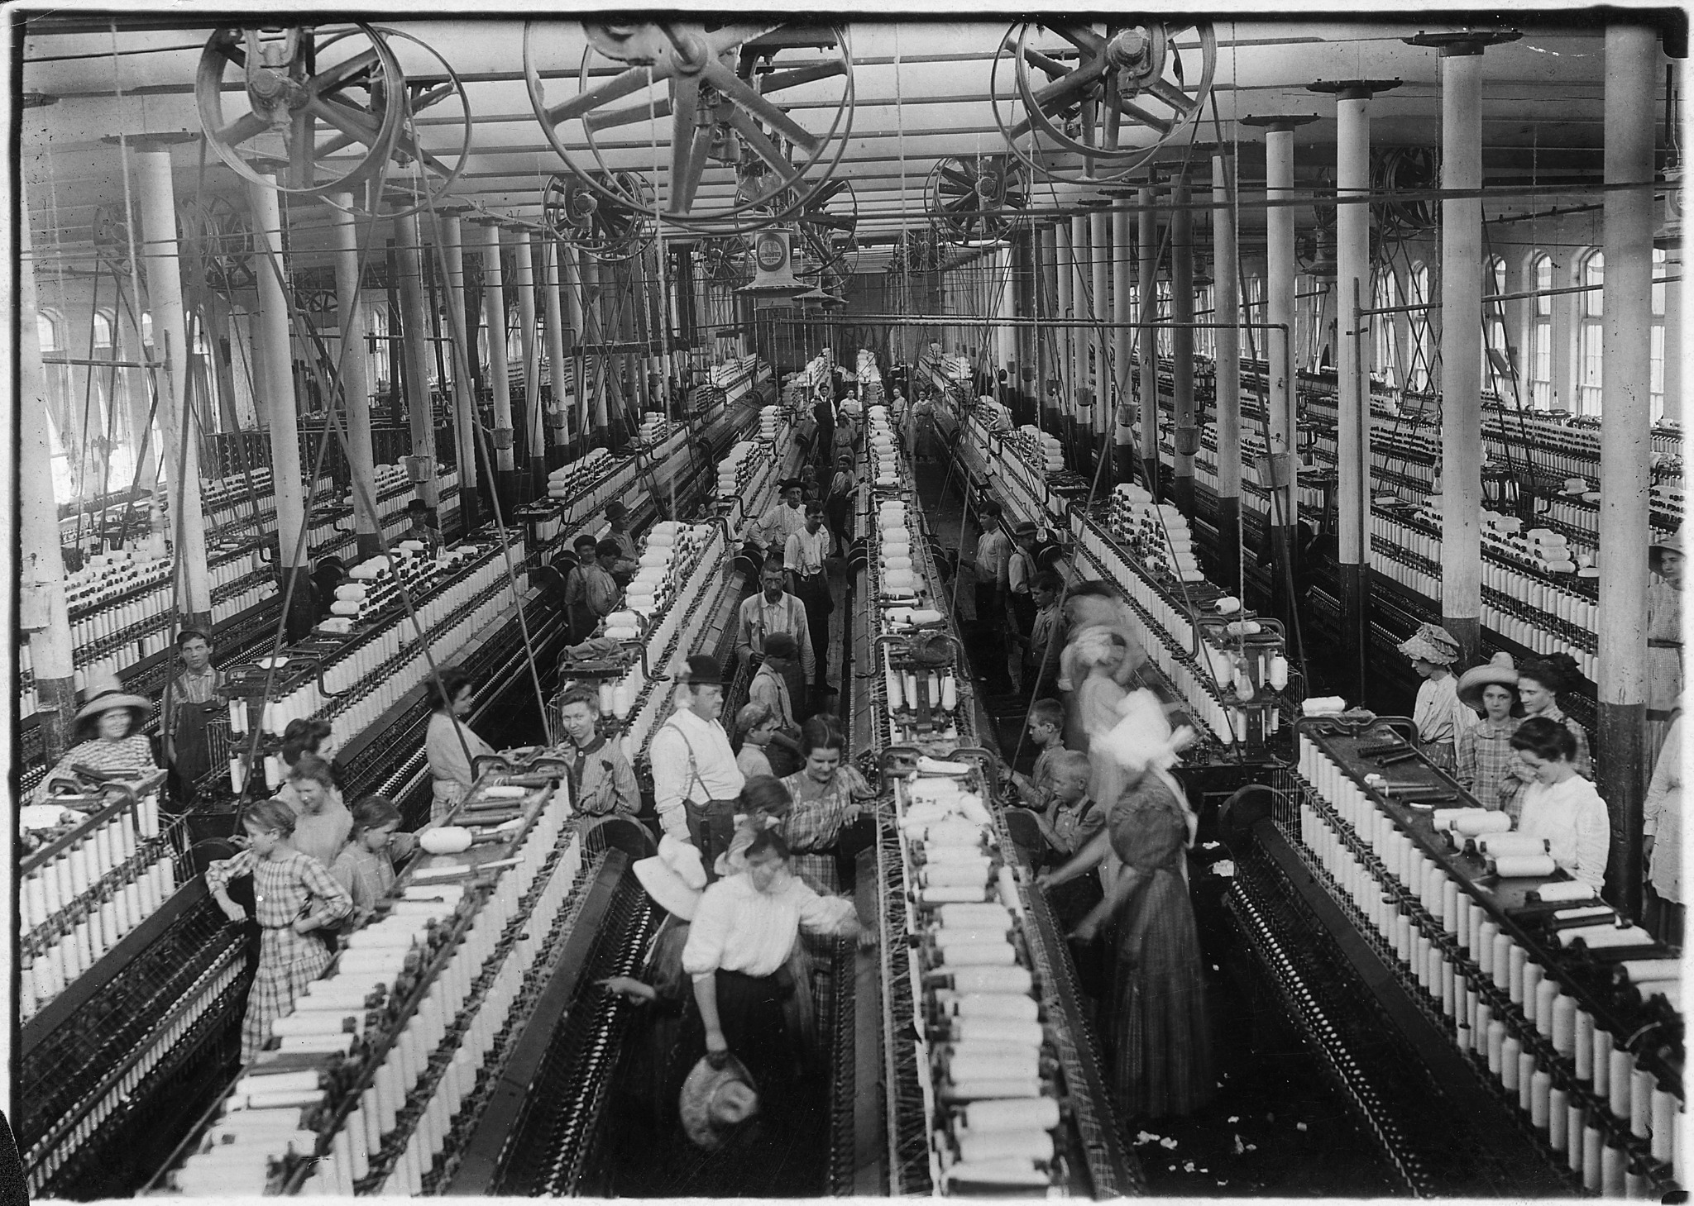
Opposition to Abolitionism
Abolitionists were still a minority with only around 10% of northerners and midwesterners supporting the movement
Slaveries proponets were more argessive and numerous
Wealthy men feared that attack on slave property would become and assault on all property
Northern merchants and textile manufacturer supported southern plantations who supplied them with cotton
Most whites opposed amalgamation (mixed race marriage)
Notes:
Gus Keish

